Slide 1

Geometry
Unit 10, Lesson 7 Solving Problems Involving Intersecting Chords Volume 2, pg. 153

Slide 2


Benchmark
MA.912.GR.6.2
Solve mathematical and real-world problems involving the measures of arcs and related angles.
volume 2, pg. 153

Slide 3
Integrated Mathematical Thinking and Reasoning Standards
MA.K12.MTR.1.1 Actively participate in effortful learning both individually and collectively.
MA.K12.MTR.2.1 Demonstrate understanding by representing problems in multiple ways.
MA.K12.MTR.4.1 Engage in discussions that reflect on the mathematical thinking of self and others.
MA.K12.MTR.5.1 Use patterns and structure to help understand and connect mathematical concepts.
MA.K12.MTR.6.1 Assess the reasonableness of solutions.
MA.K12.MTR.7.1 Apply mathematics to real-world contexts.
volume 2, pg. 153

Slide 4

Learning Target
I can solve problems involving chords of a circle and their related angles.
volume 2, pg. 153

Slide 5

Warm-Up
volume 2, pg. 154

Slide 6
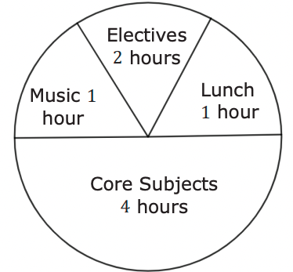
10.7.1 Warm-Up: Sectors
1. What do you notice about the circle graph?
2. Identify a sector that is incorrectly sized.
3. Redraw the circle graph so that the sizes are proportional to the number of hours.
volume 2, pg. 154

Slide 7

Exploration
volume 2, pg. 154

Slide 8

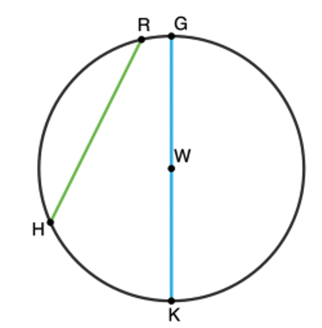
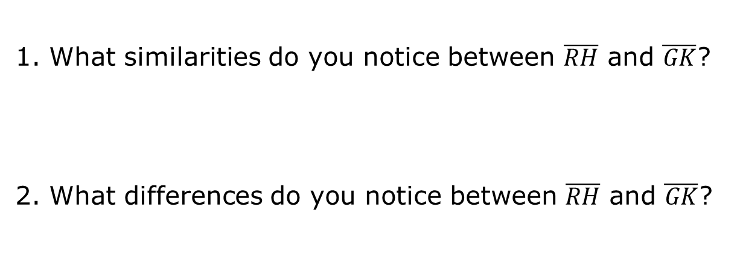
10.7.2 Exploration: Chords
Circle W is shown where points R, G, K, and H lie on the circle.
1. What similarities do you notice between $\overline{RH}$ and $\overline{GK}$?
2. What differences do you notice between $\overline{RH}$ and $\overline{GK}$?
volume 2, pg. 154

Slide 9

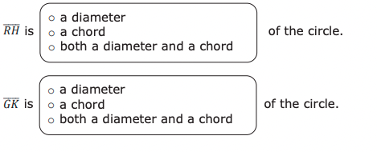
3. Complete the statements.
volume 2, pg. 155

Slide 10

Collaboration
volume 2, pg. 155

Slide 11

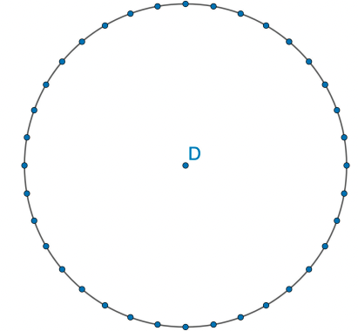
10.7.3 Collaboration: Angles in Intersecting Chords
With your partner, complete the following using Circle D.
Draw and label two chords that intersect inside the circle, making sure the endpoints fall on the points. When drawing the chords, do not draw the same chords as your partner and avoid drawing diameters.
volume 2, pg. 155

Slide 12
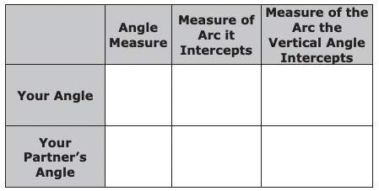
b. Choose one of the angles to measure and label. Then, complete the table.
c. Discuss the following with your partner.
• What do you notice about the values in the table?
• What do you think the relationship is between the angle measure and the two intercepted arcs?
volume 2, pg. 156

Slide 13
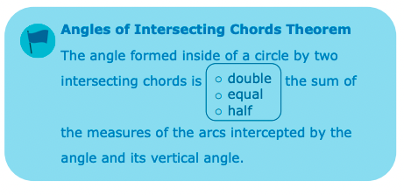
d. Write a formula that generalizes your discovery from the discussion you had in Part C.
e. Complete the statement.
volume 2, pg. 156

Slide 14

Guided Practice
volume 2, pg. 157

Slide 15

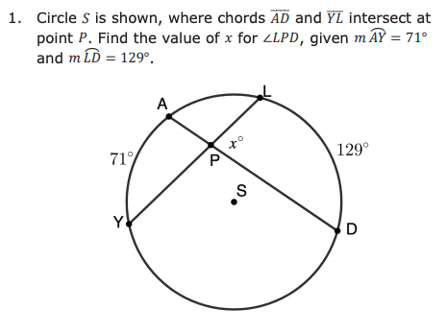
10.7.4 Guided Practice: Solving Problems Involving Angles in Intersecting Chords
volume 2, pg. 157

Slide 16
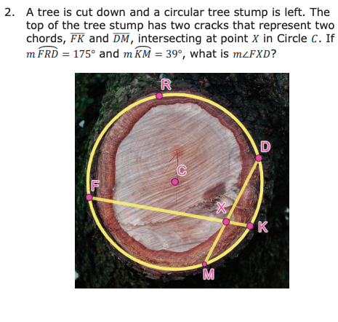
volume 2, pg. 157

Slide 17
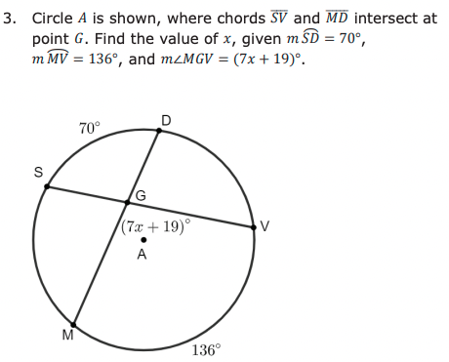
volume 2, pg. 158

Slide 18

Your Turn
volume 2, pg. 158

Slide 19
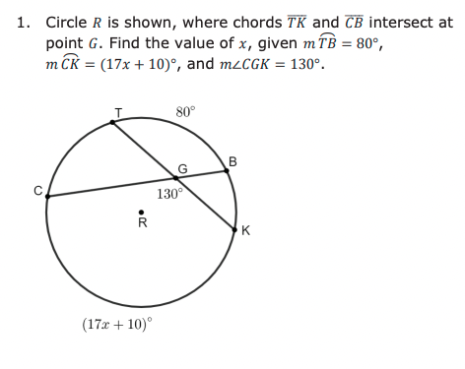
10.7.5 Your Turn!
volume 2, pg. 158

Slide 20

Wrap-Up
volume 2, pg. 159

Slide 21
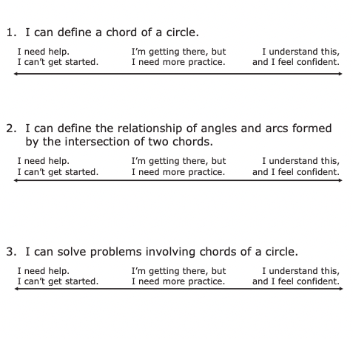
10.7.6 Wrap-Up: Reflection
Draw an X on each line to indicate where your current learning is in relation to solving problems involving chords.
volume 2, pg. 159

